Slide 1
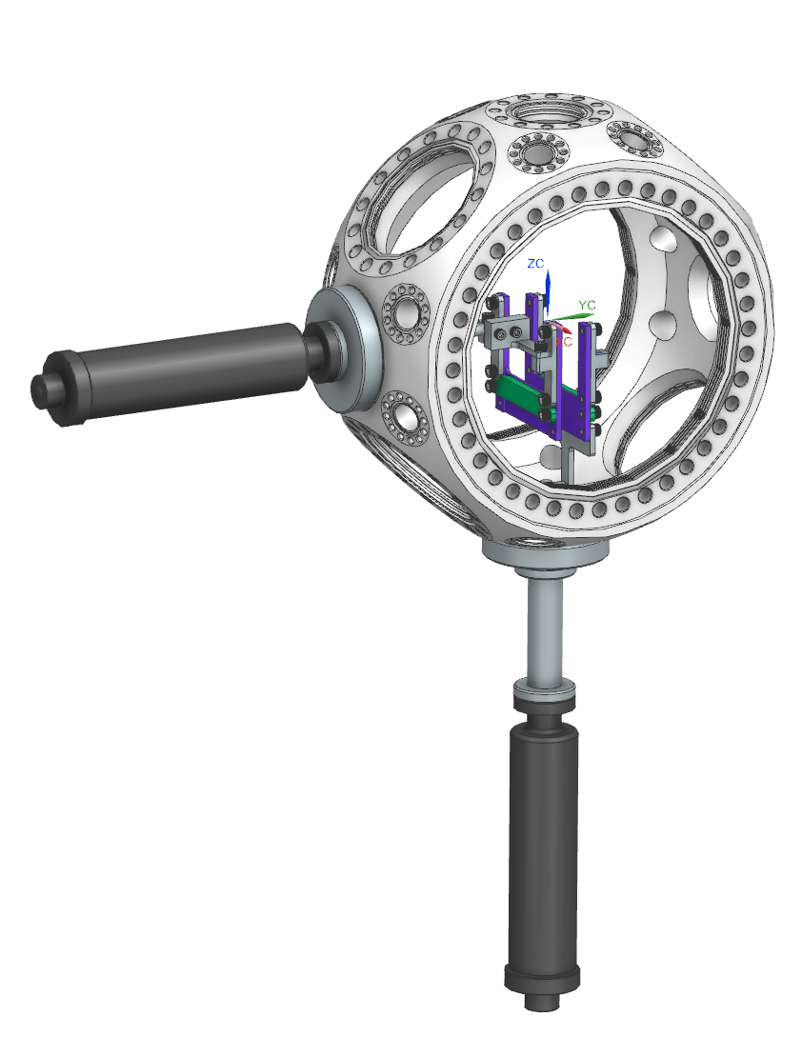
Full Assembly

Slide 2
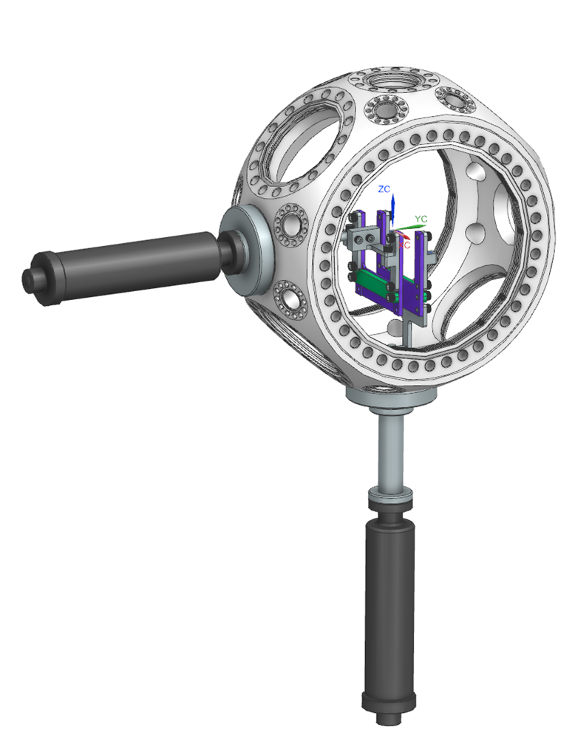
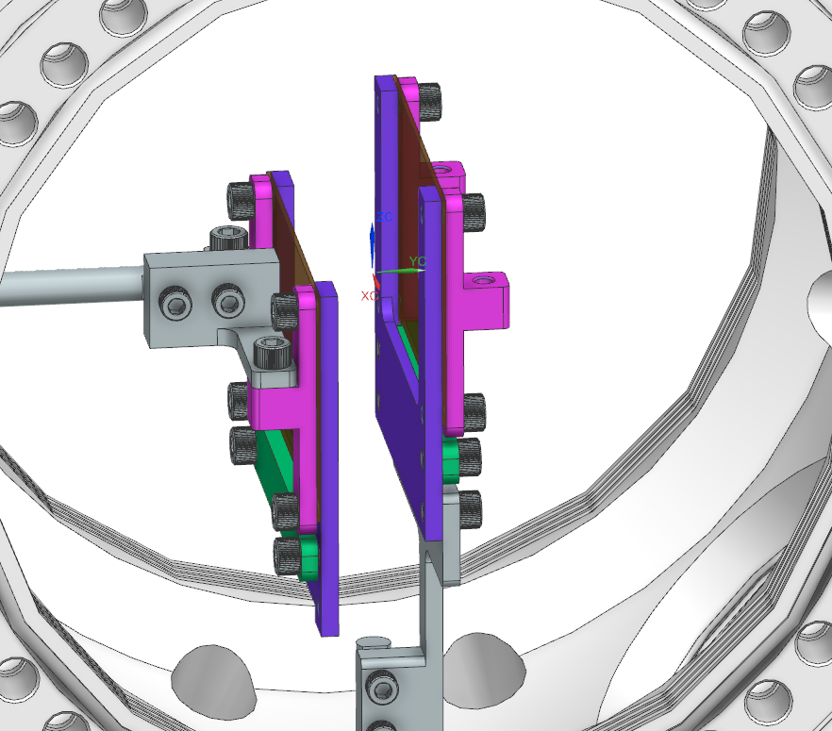
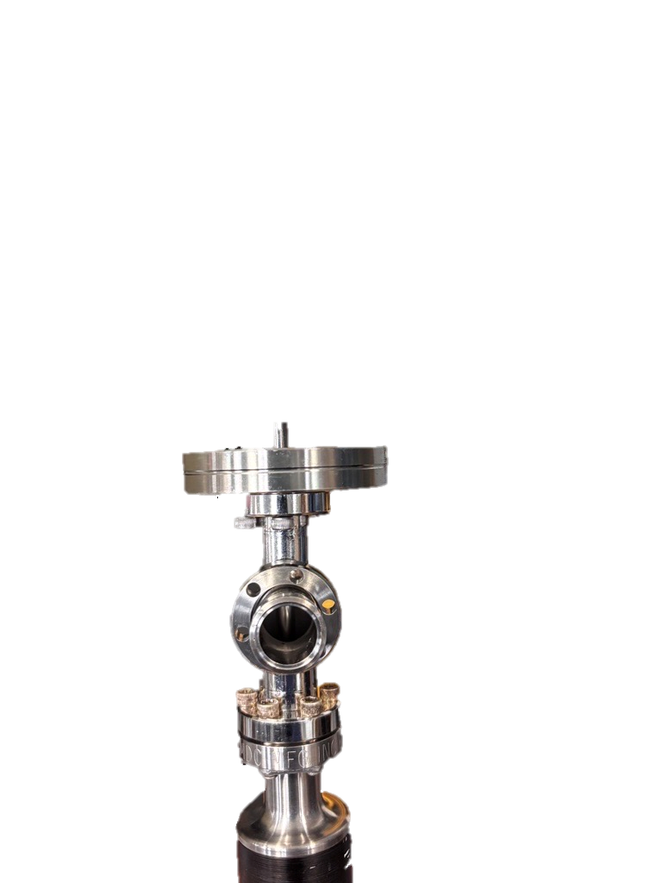
1. Install Linear Actuators
2.75” -> 1.33” Flange Adapter
“T” Extension
MDC Linear Passthrough
Horizontal Actuation
Vertical Actuation

Slide 3
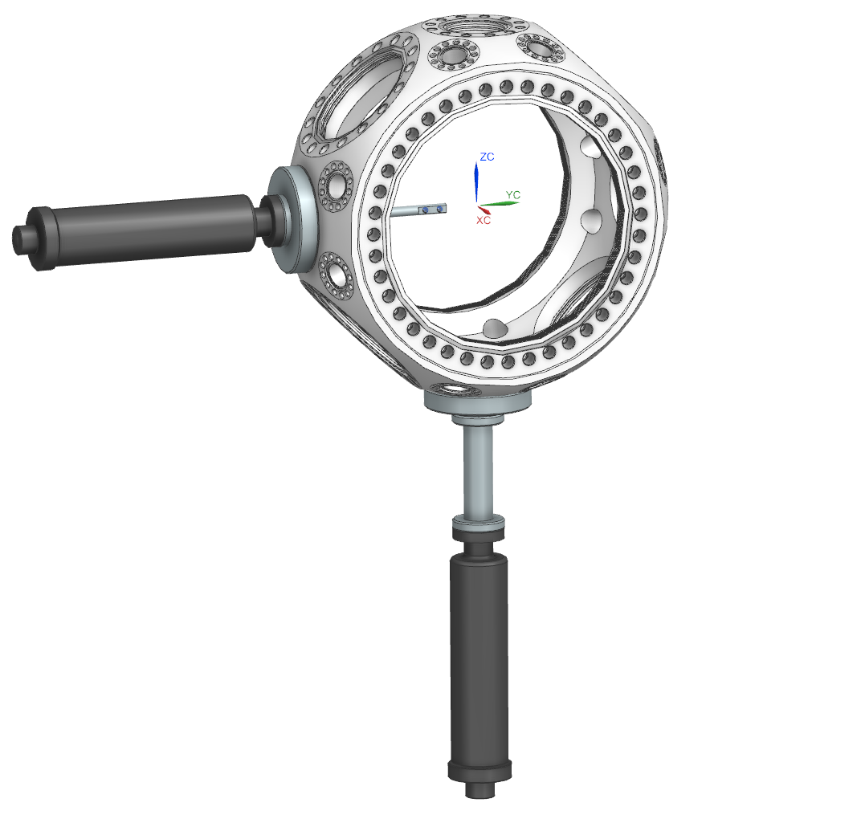
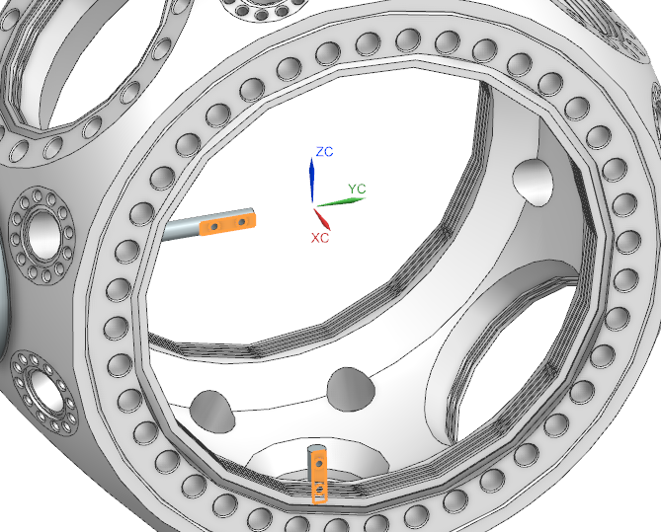
1. Install Linear Actuators
2.75” -> 1.33” Flange Adapter
“T” Extension
MDC Linear Passthrough
NOTE END EFFECTOR ORIENTATION

Slide 4
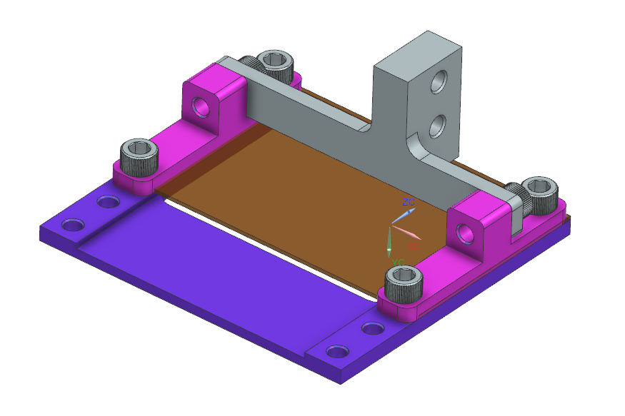
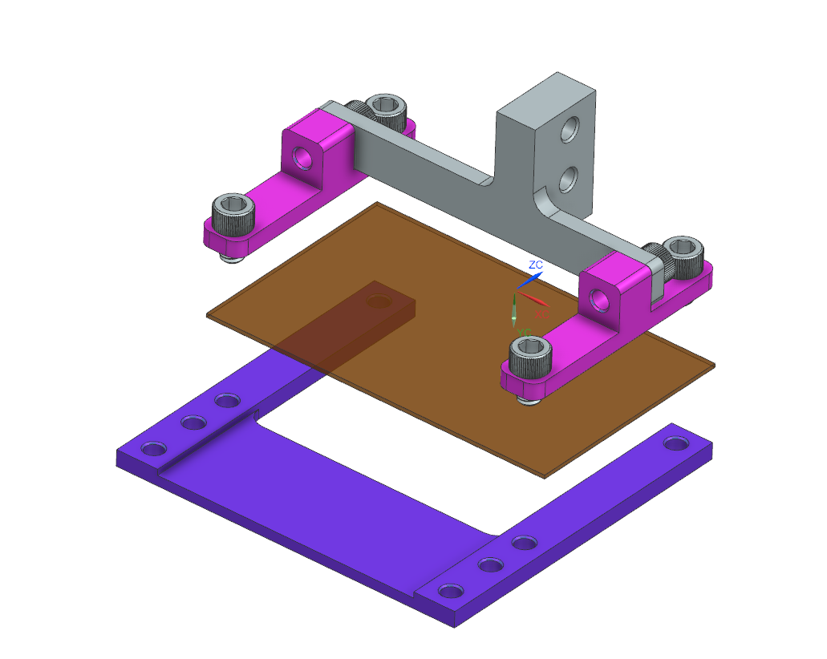
2. Assemble Horizontal Actuation
2x Mesh Clamp
Horizontal Mount
6x #8-32 ¼” bolts
Mesh
Film Plate

Slide 5
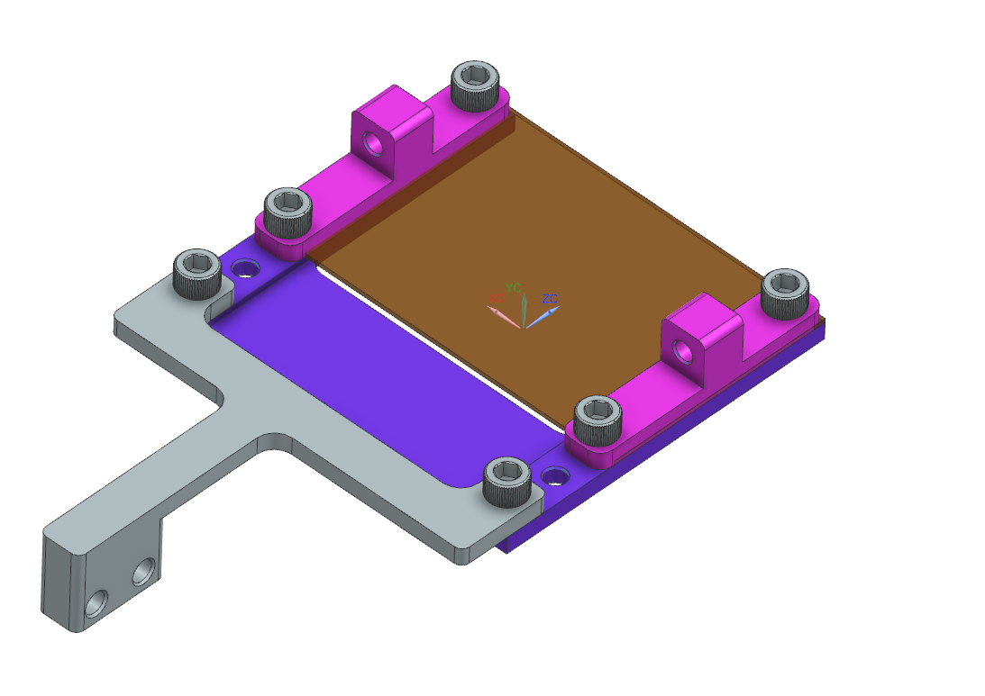
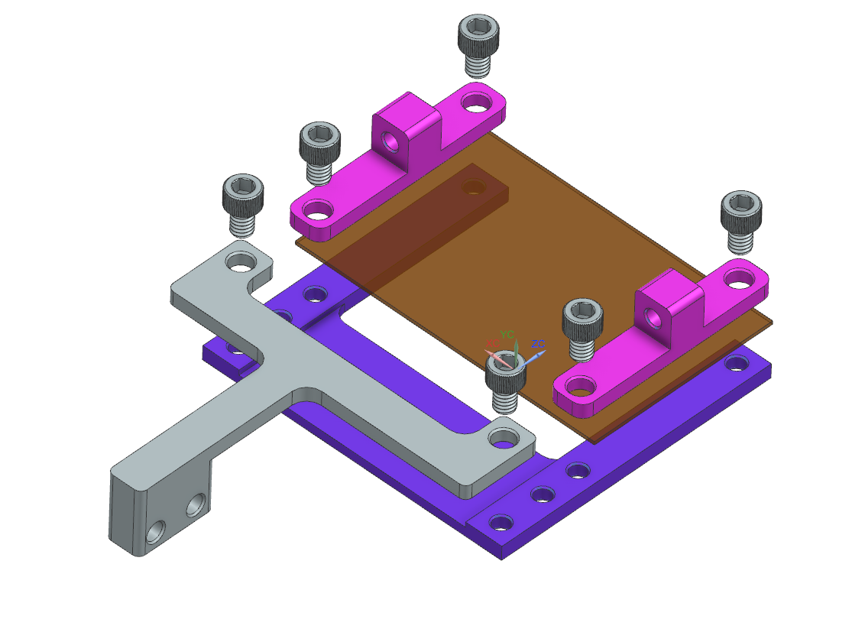
3. Assemble Vertical Actuation
2x Mesh Clamp
Mesh
6x #8-32 ¼” bolts
Film Plate
Vertical Mount

Slide 6
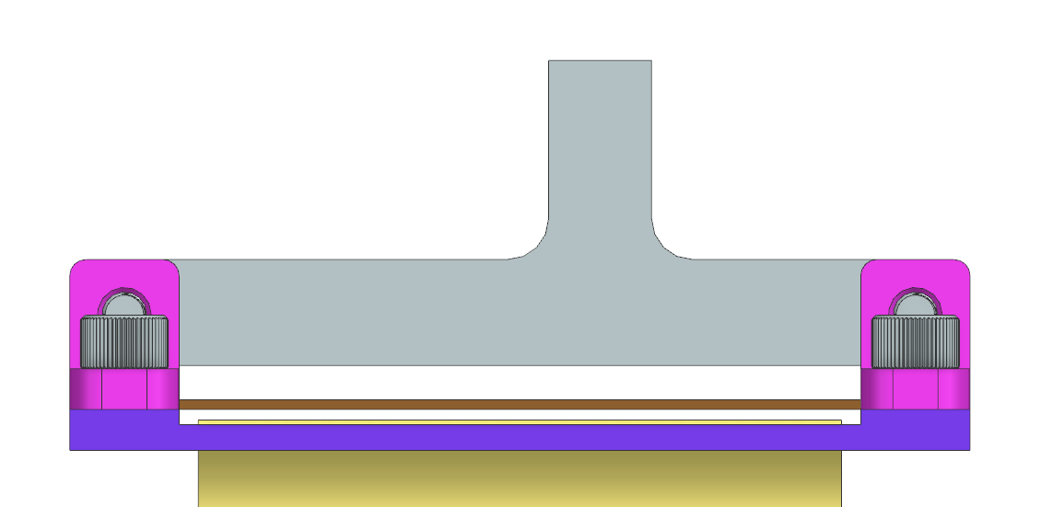

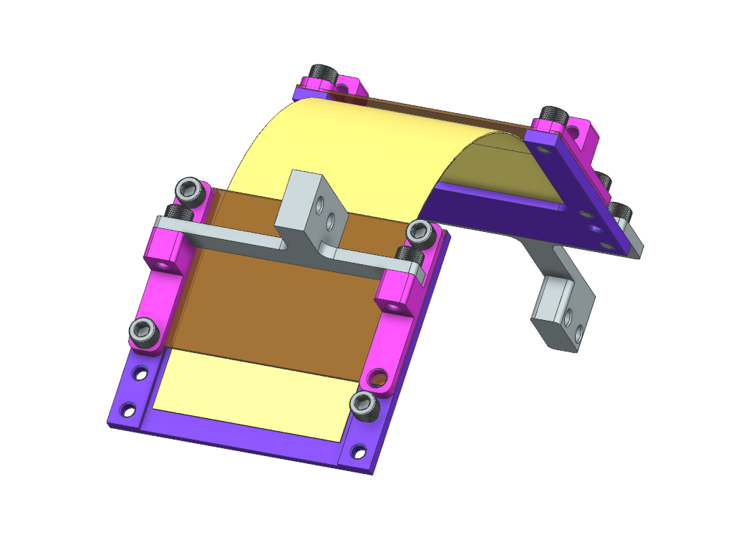
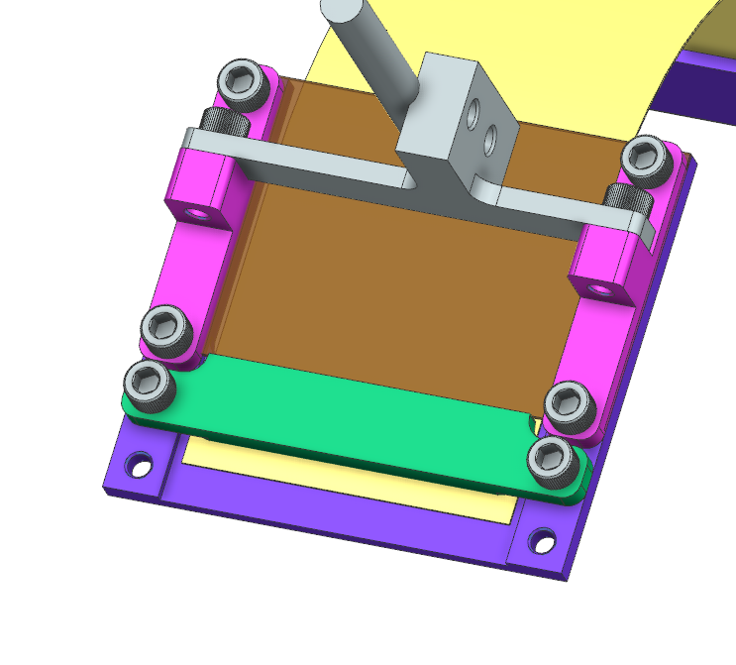
4. Install Film
Film
Mesh
Film Plate
Slide film underneath mesh
Film Clamp
2x #8-32 ¼” bolts

Slide 7
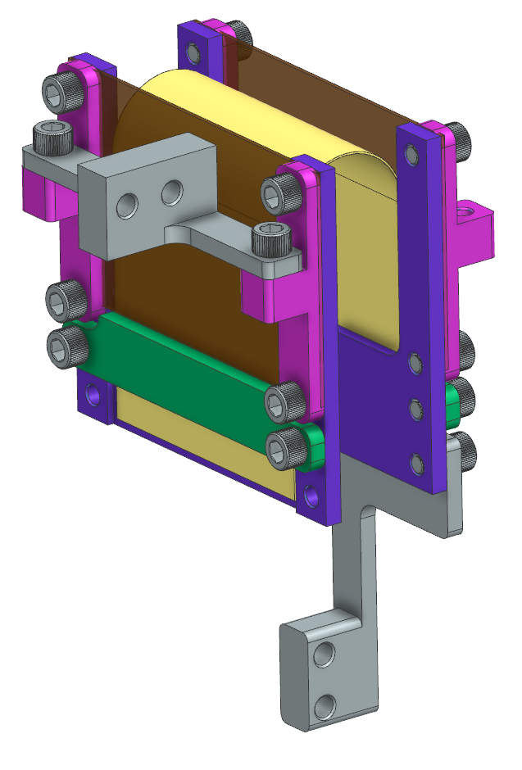
4. Install Film

Slide 8
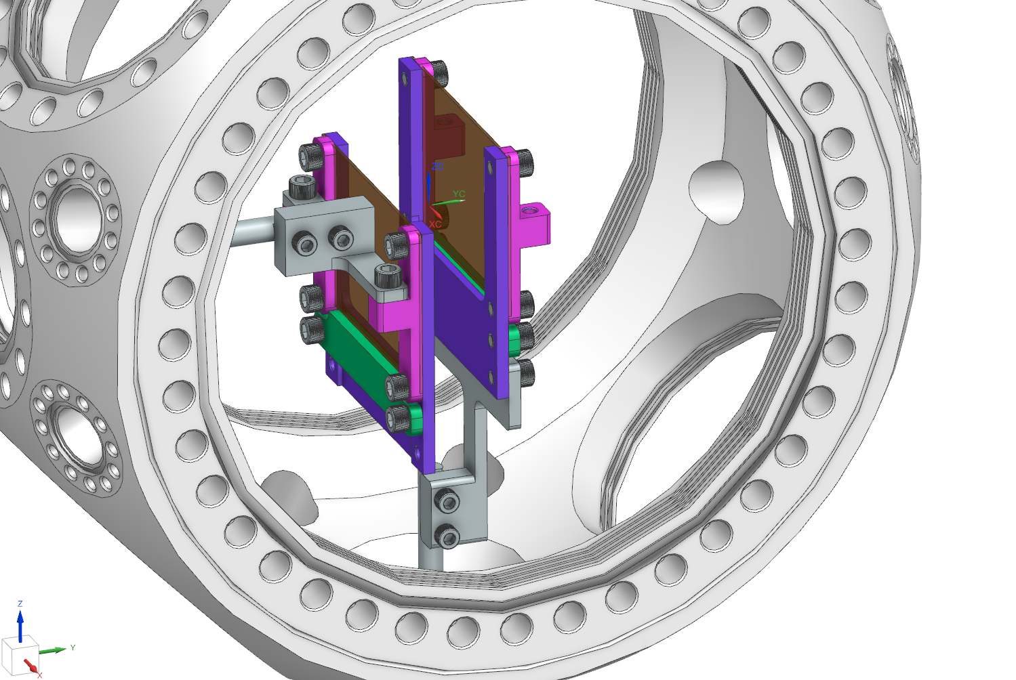
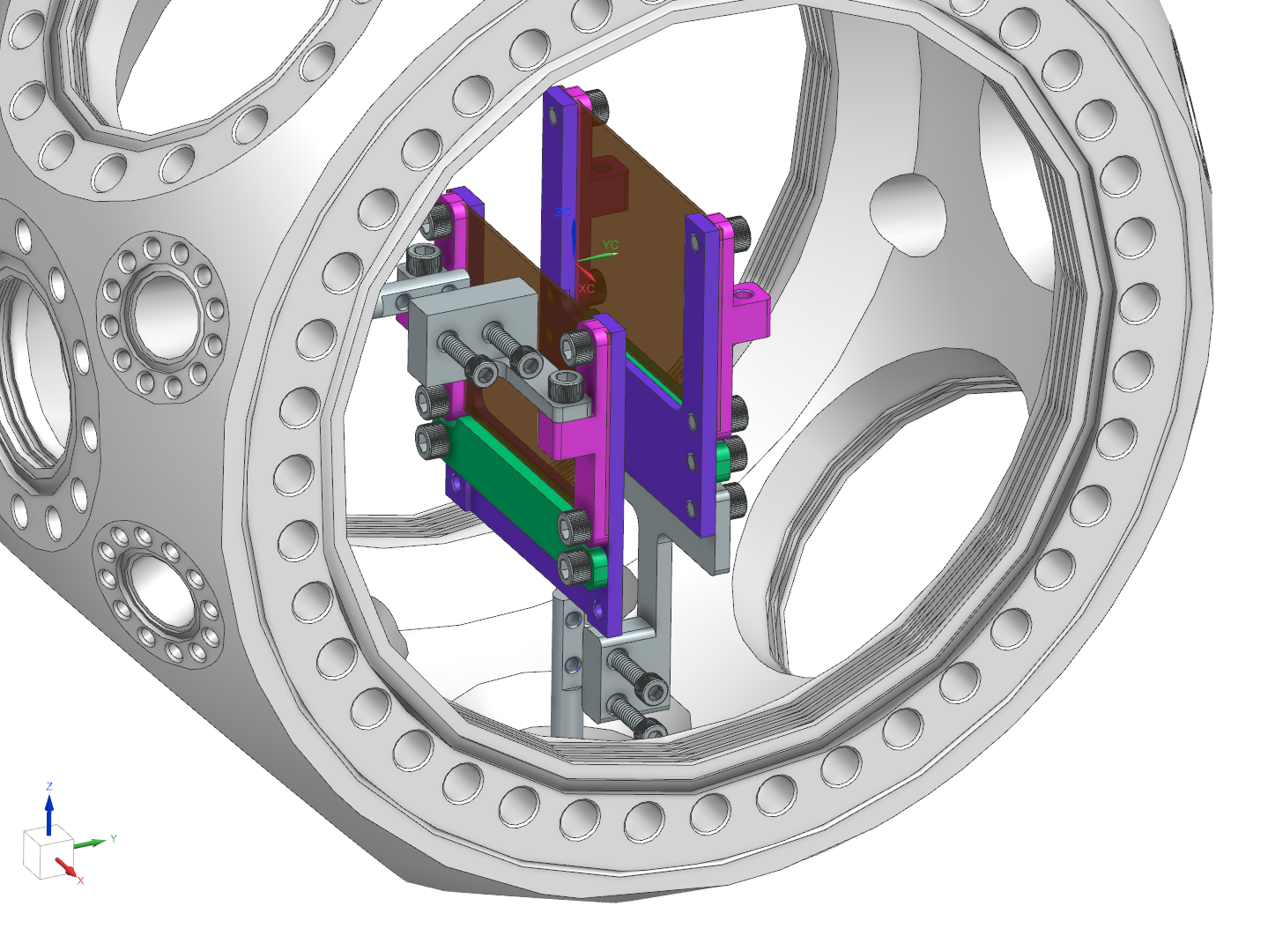
5. Install in Chamber
Vertical Actuation
4x #6-32 ½” bolts
Horizontal Actuation

Slide 9
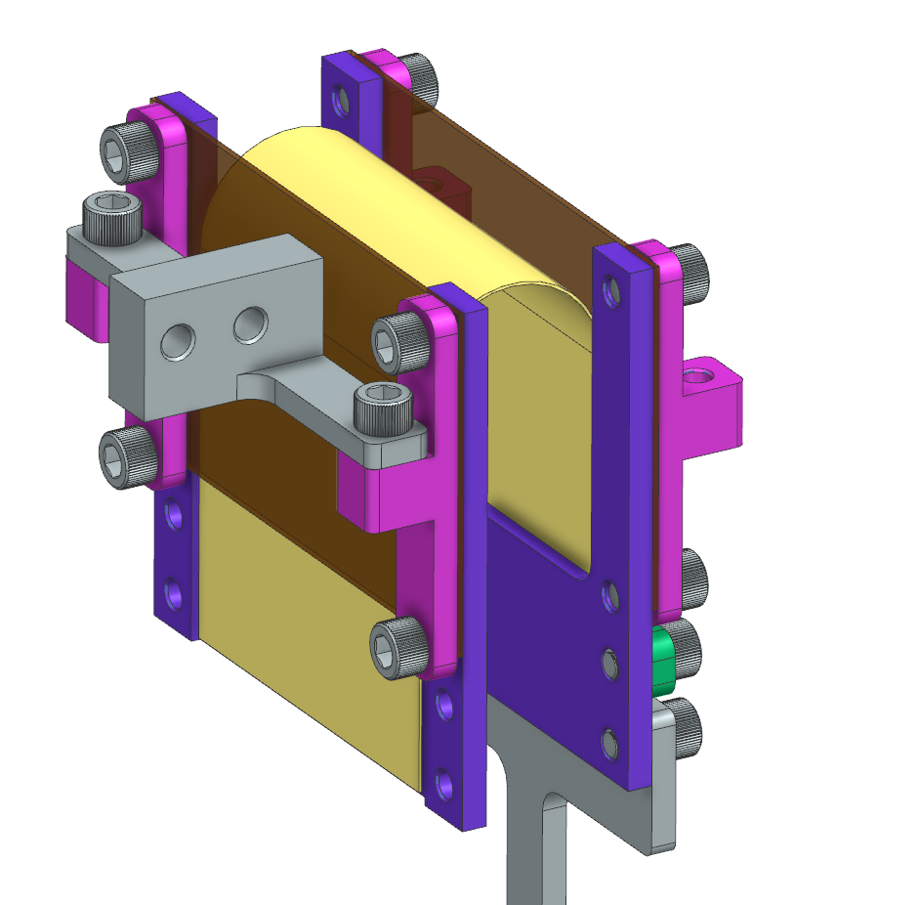
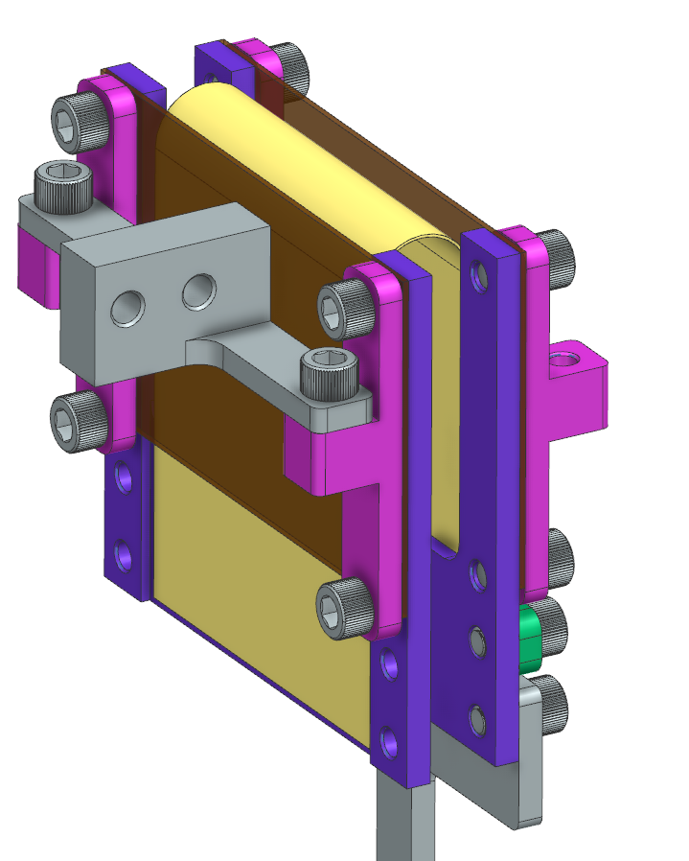
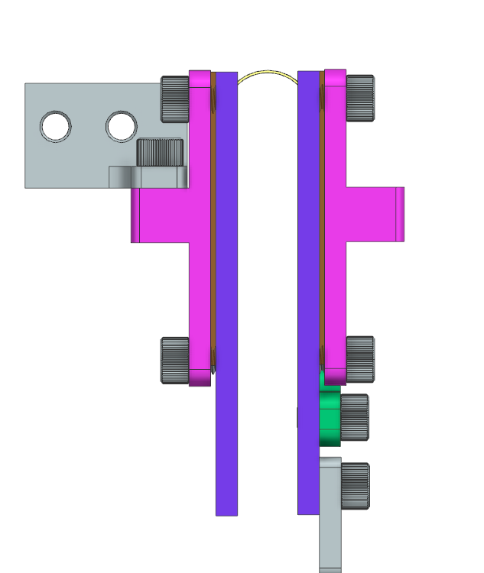
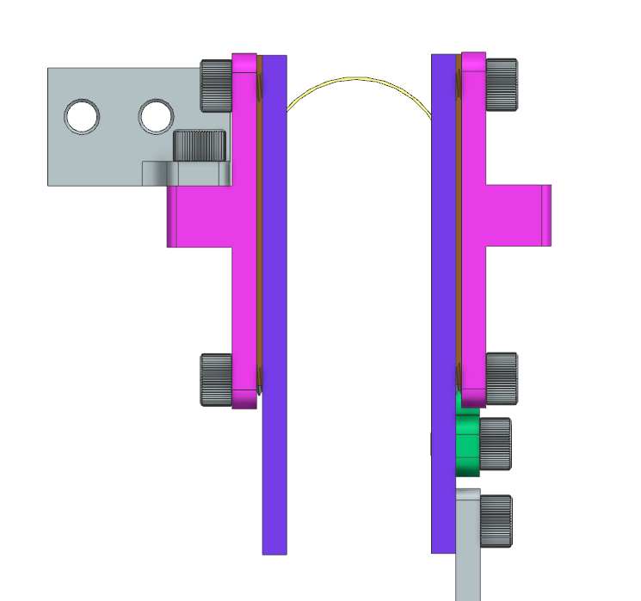
R = 12mm
R = 6mm

Slide 10
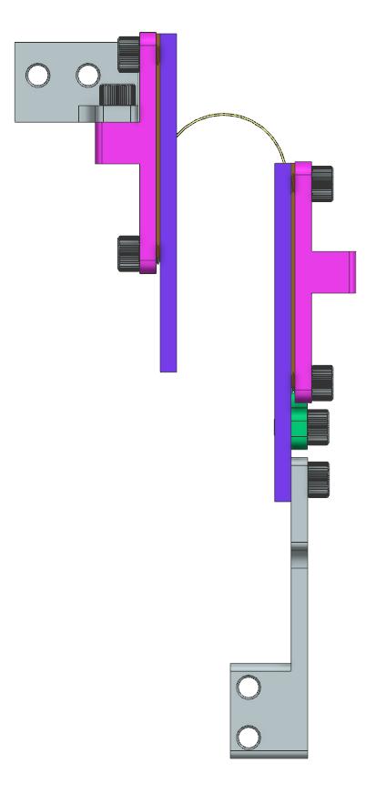
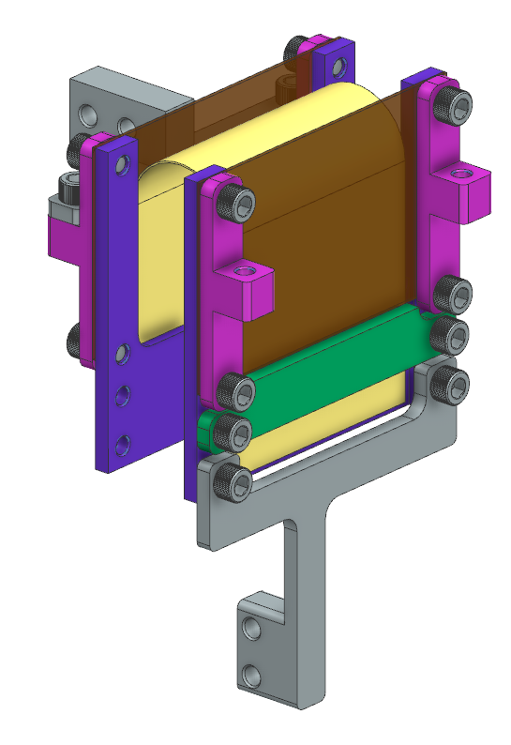
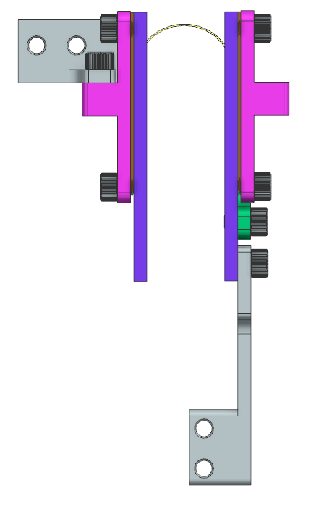
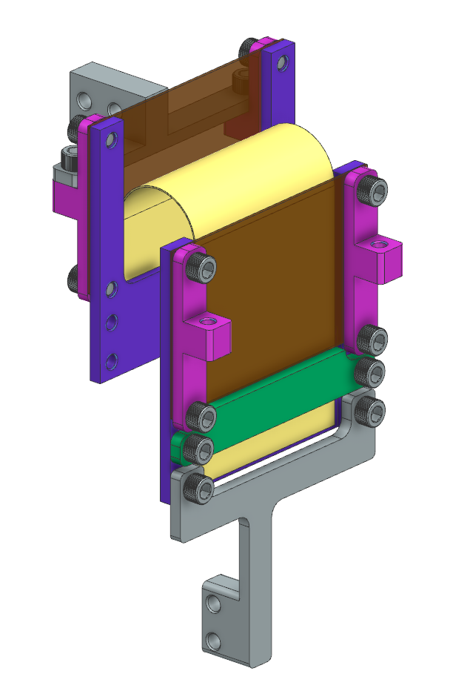
Neutral Position
1” Sweep

Slide 11
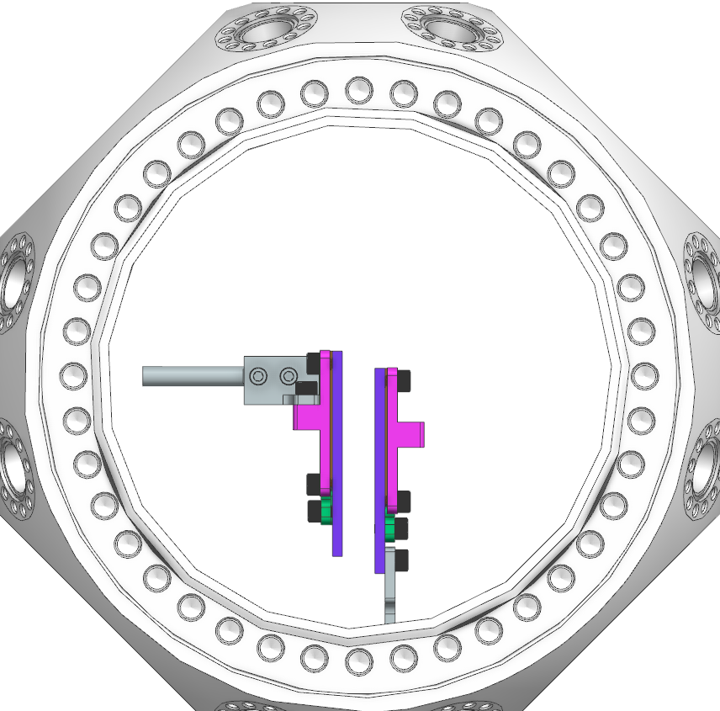
10mm
Radius Adjustment
45mm
Stroke Length

Slide 12
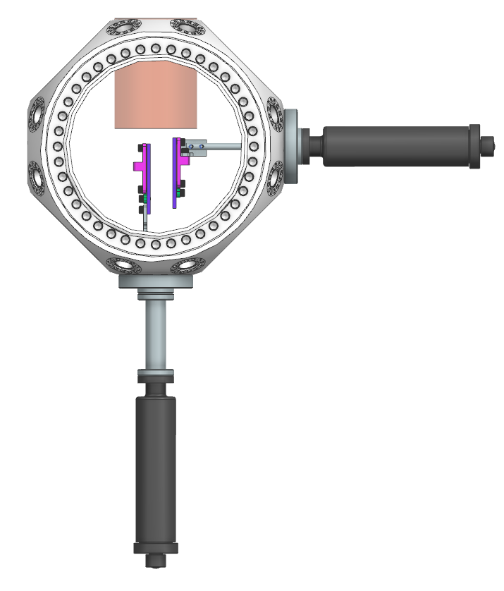
270mm

